Slide 1
Pitch Transposer – Audio Sampler
Rajiv Gandhi University of Knowledge Technologies
Presented by : G Jeevan(R200783)
Under the guidance of:
Dr. SK Mahammad Rafi M. Tech, Ph.D
Assistant Professor, ECE Dept

Slide 2
Introduction

Slide 3
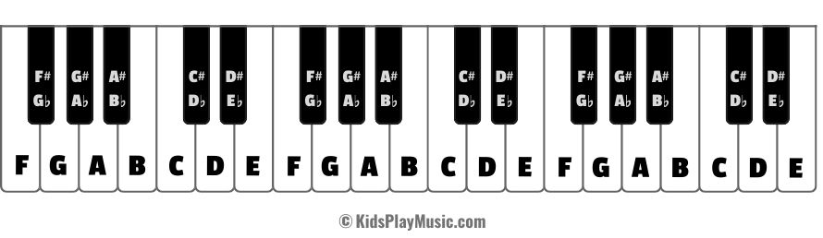

Slide 5
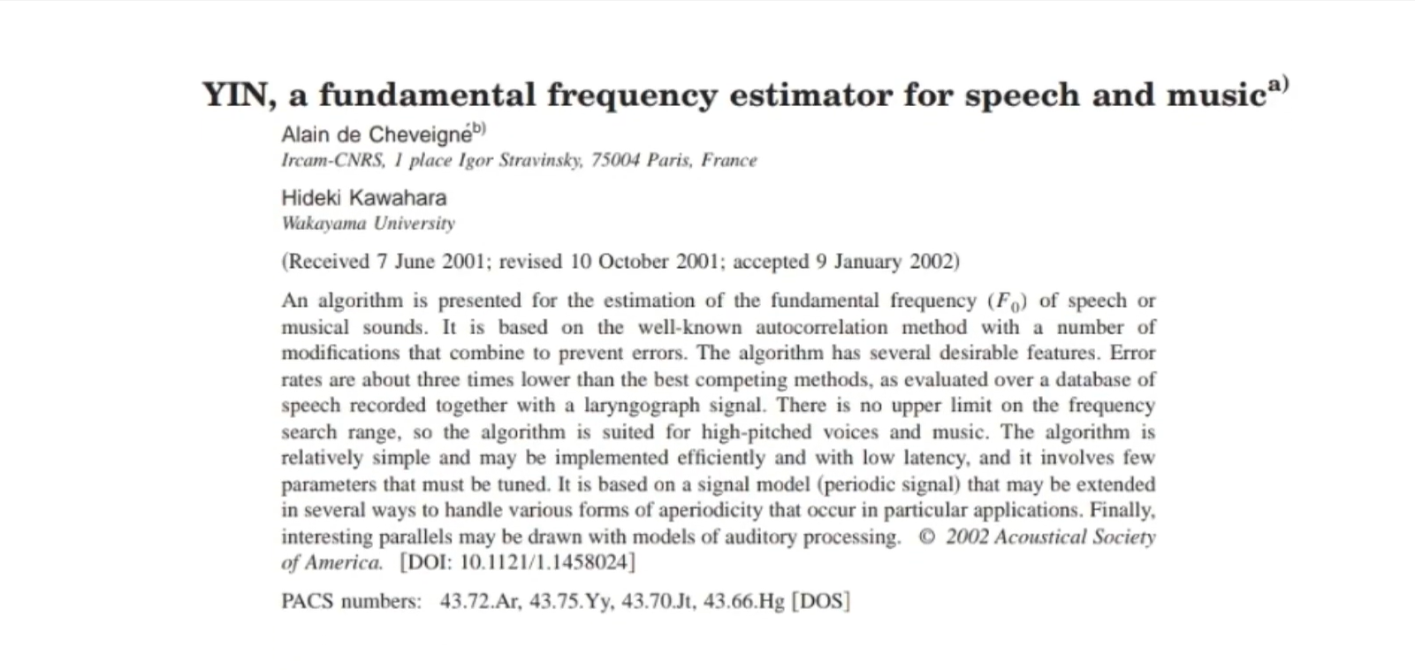

Slide 6
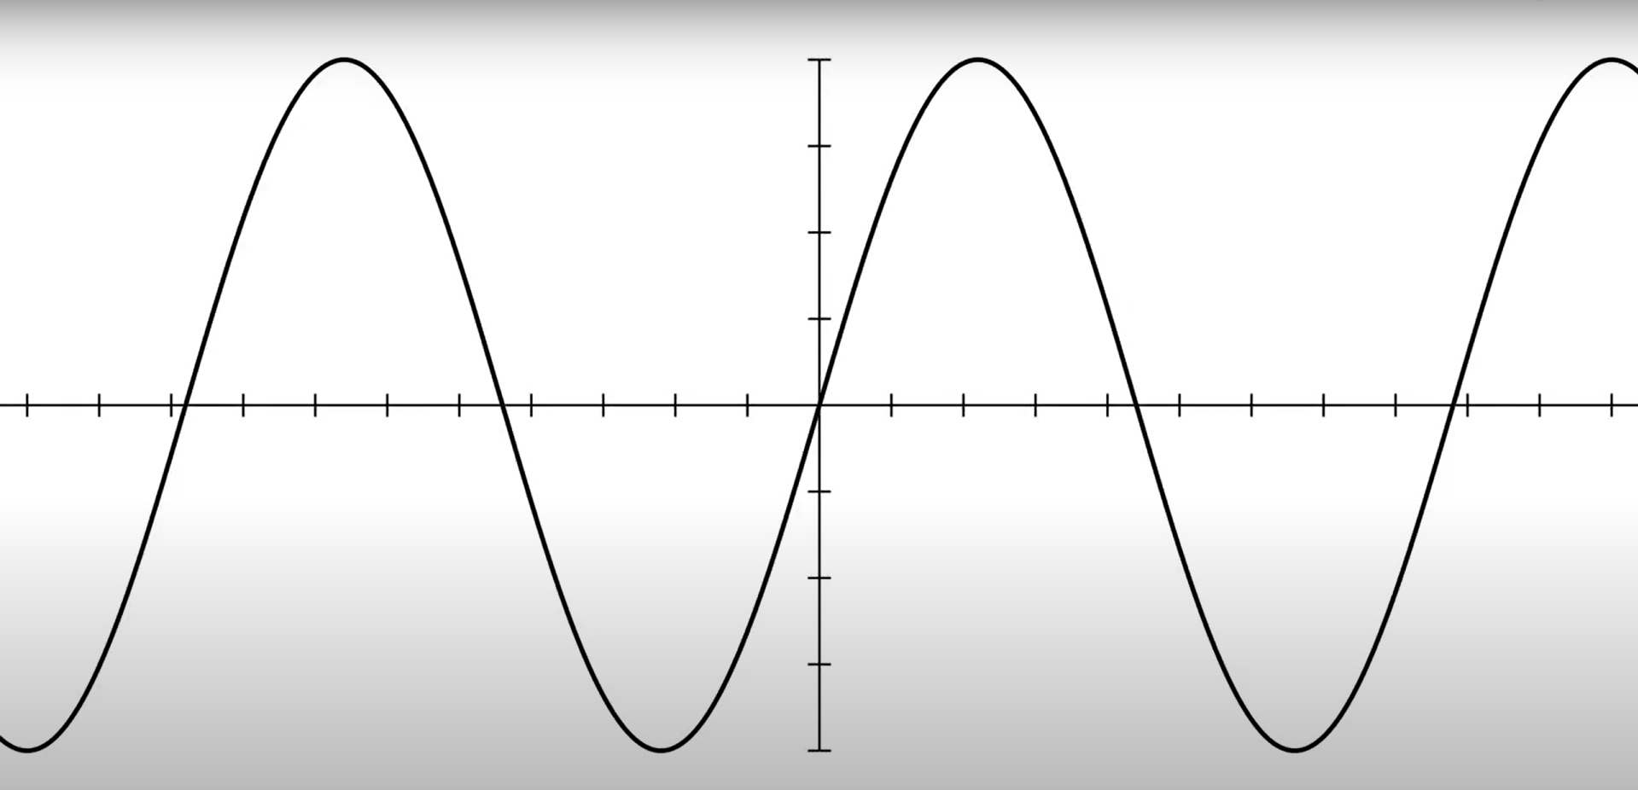

Slide 7
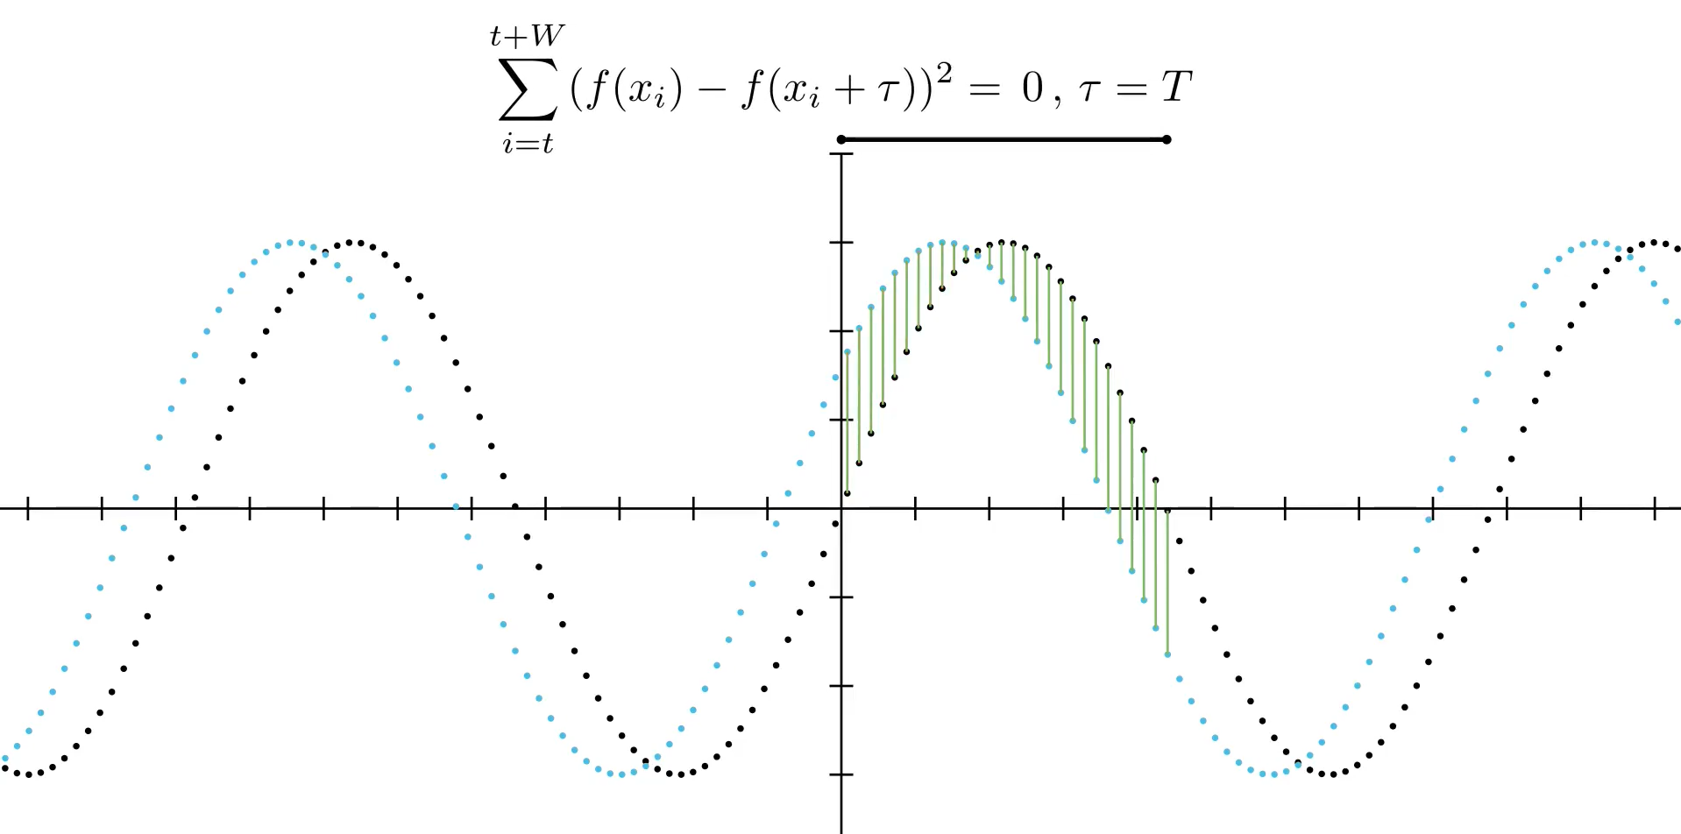

Slide 8
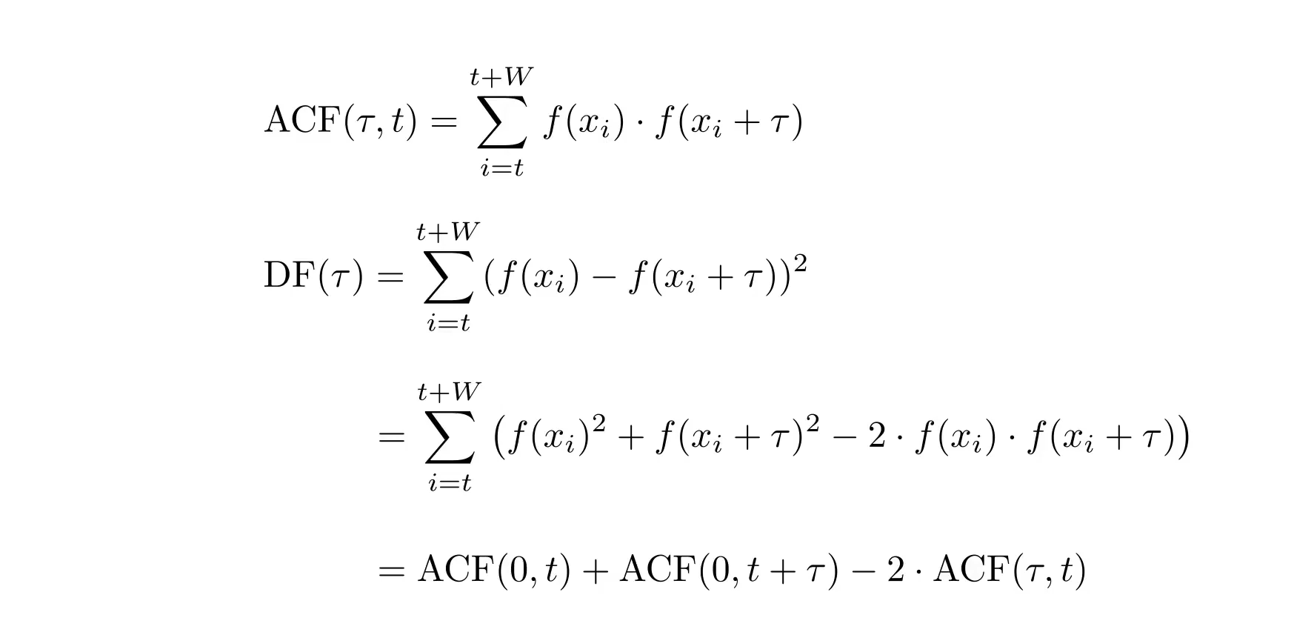

Slide 9
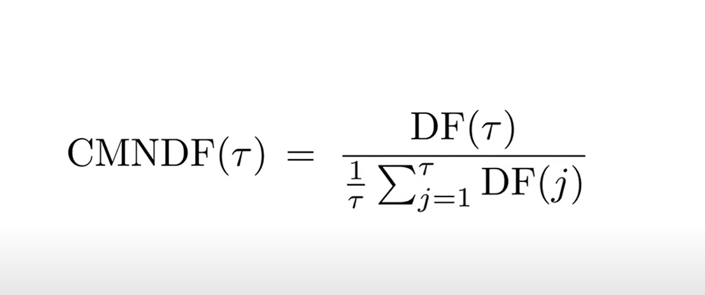

Slide 10

MIDI Conversion Formula

Slide 11
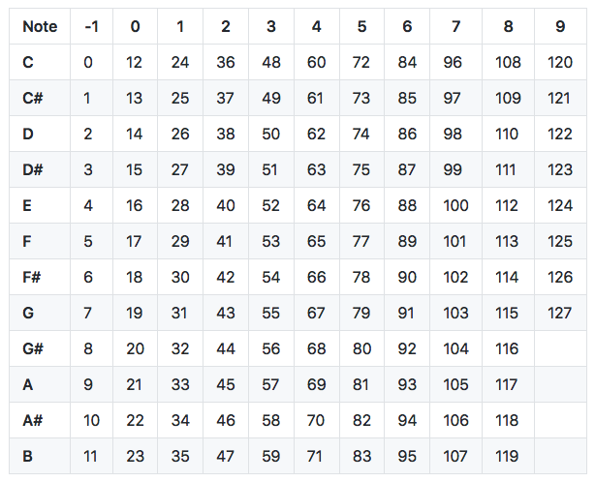

Slide 12
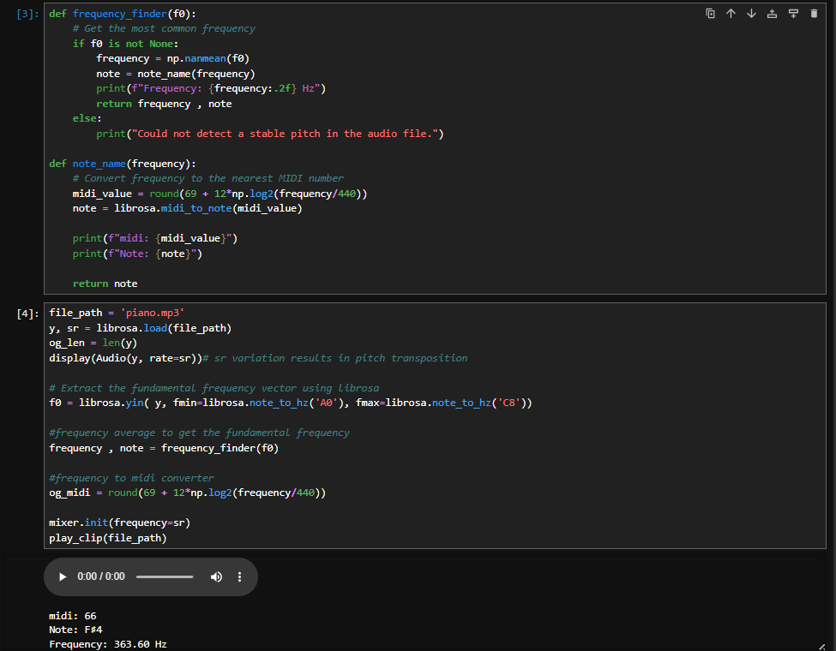

Slide 13
Pitch Transposing

Slide 14
Pitch Transposing
Overlap add

Slide 15
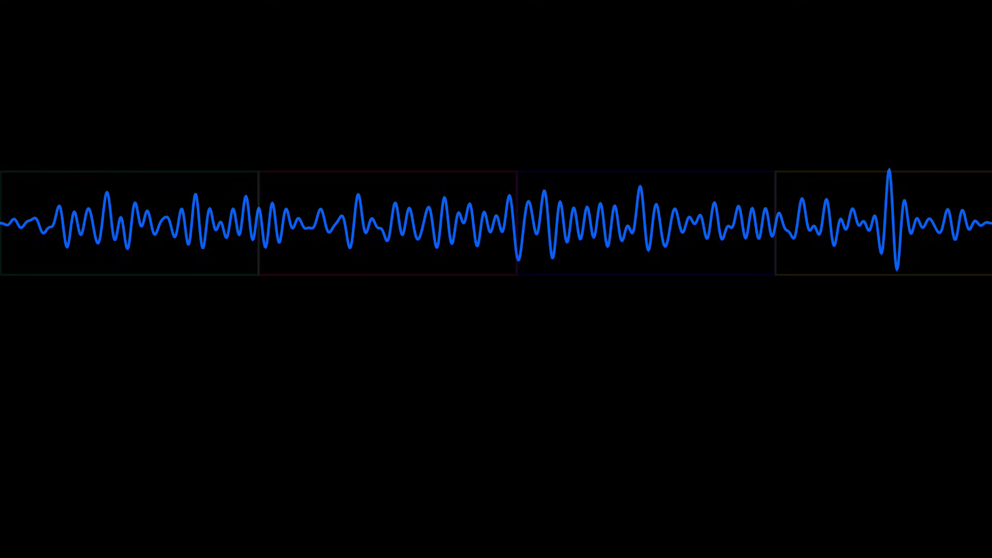

Slide 16
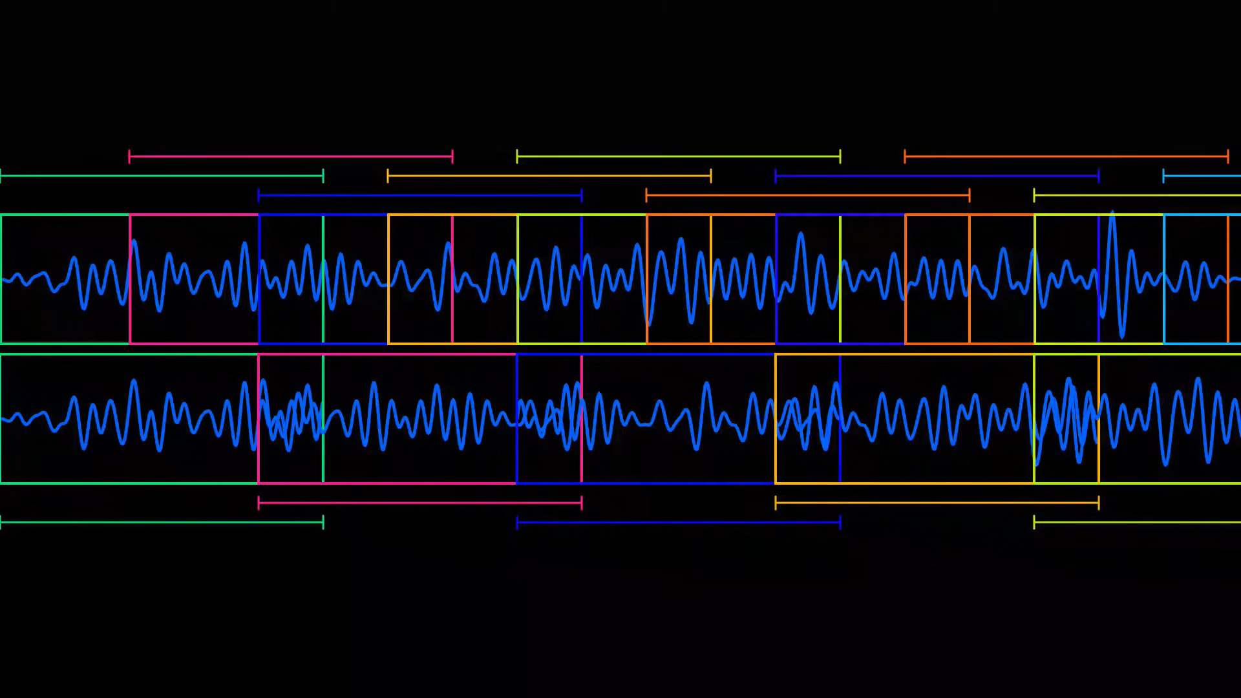

Slide 17
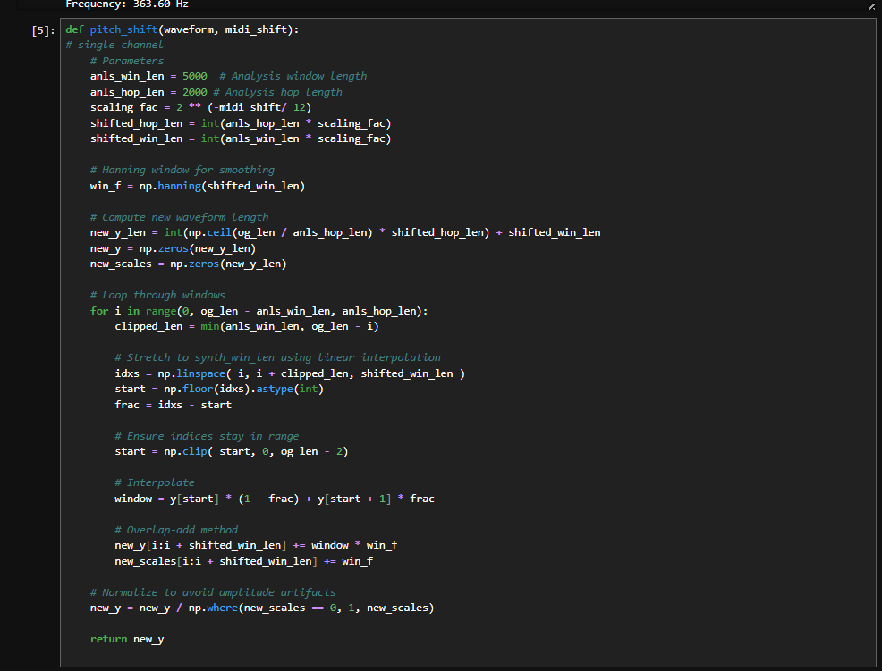

Slide 18
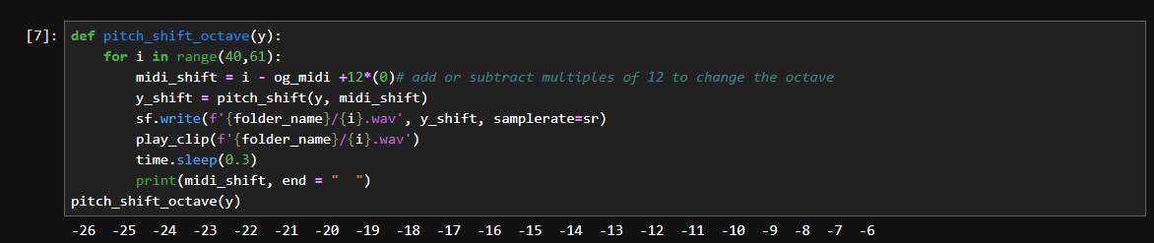

Slide 19
Creating an Interface for the application

Slide 20
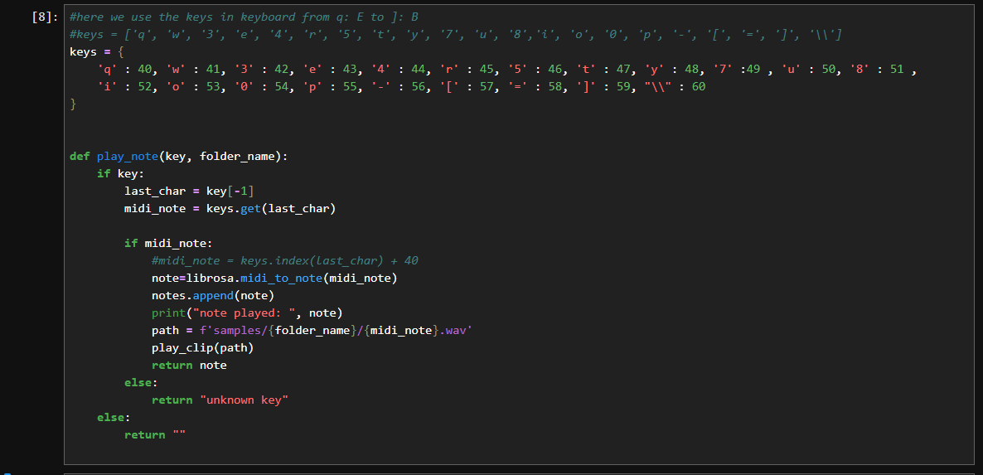

Slide 21
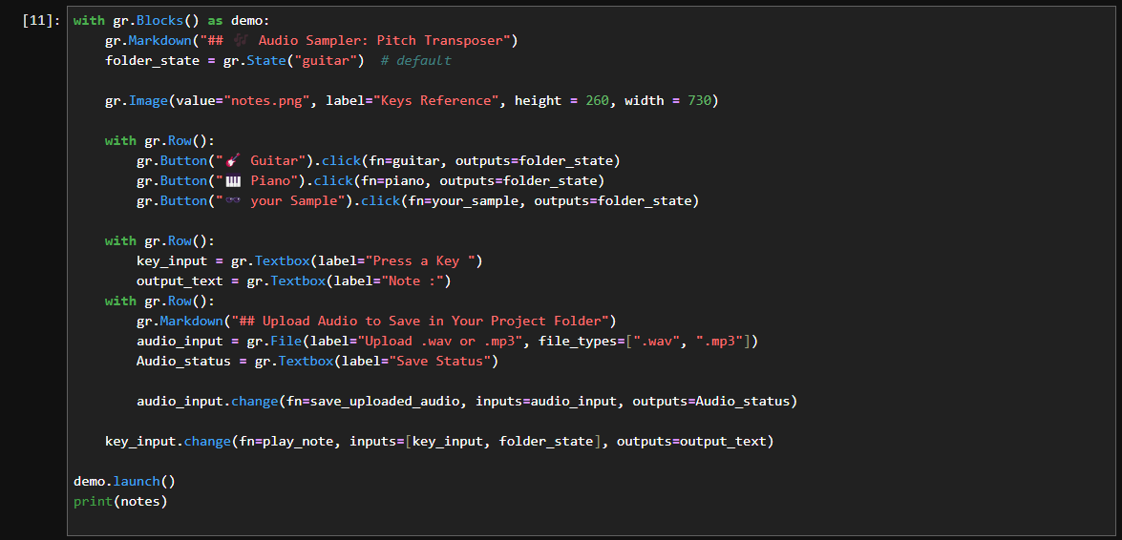

Slide 22
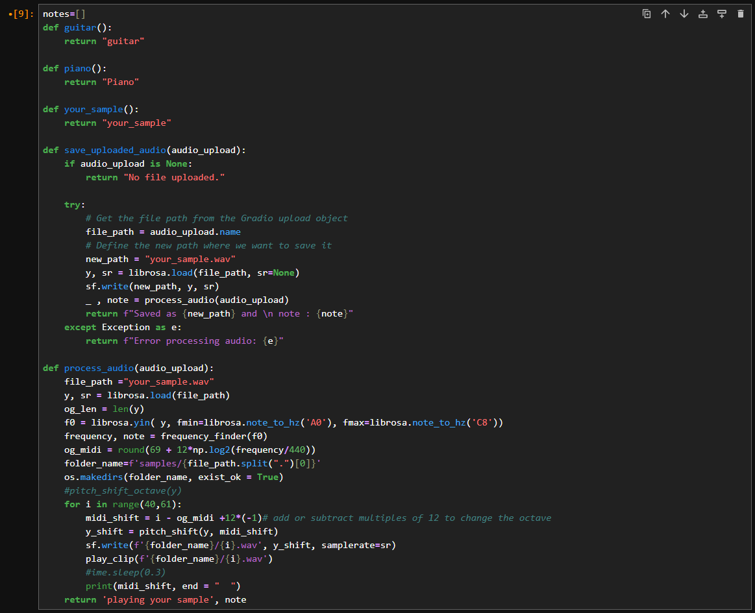

Slide 23
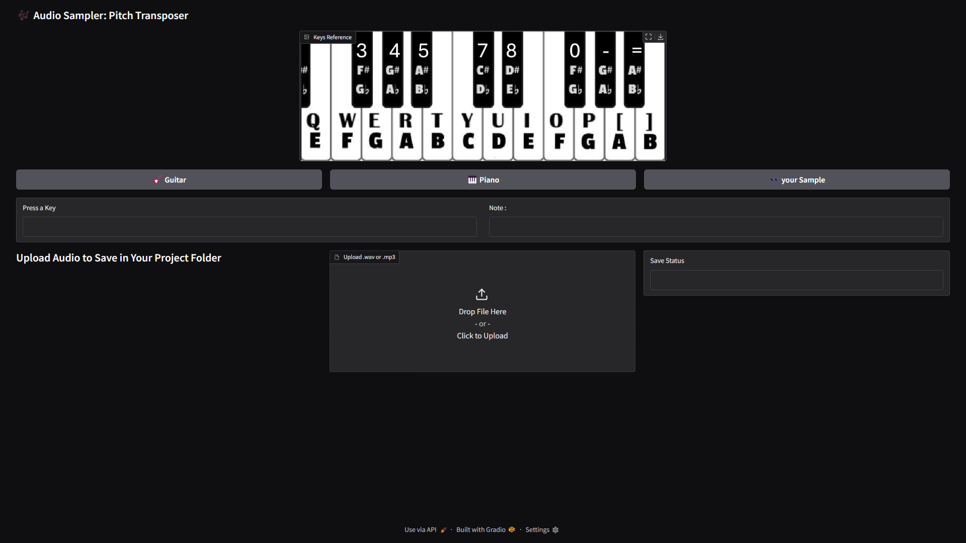

Slide 24
Scope

Slide 25
THANK YOU

